Slide 1
Module3_Part3 Textbook : Operating Systems Concepts by Silberschatz
Operating SYSTEMS

Slide 2
Mutex Locks
The hard ware based solution Test and Set Lock for critical section problem
is complicated and inaccessible to programmers.
Another software tool used to solve critical section problem is Mutex Locks.
We use murex locks to protect critical regions and avoid race conditions
Process must acquire lock before entering the critical region and release the lock when it exits.
The acquire function() acquire the lock and release function() releases the lock

Slide 3
Mutex locks
Mutex has a boolean variable available whose value indicates lock is available or not
if lock is available call to acquire() succeeds; the lock is then considered unavailable
the process attempt to acquire unavailable lock is blocked until the lock is available
acquire() {
while(!available)
;/* busy wait*/
available:=false;
}
The definition of release() as follows
release() {
available=true;
}

Slide 4
Mutex locks
do {
Call to either acquire() or release() must be performed atomically
Acquire lock
Critical section
Release lock
noncritical section
} while(true);
Solution to critical section problem using mutex locks

Slide 5
Mutex locks
The main disadvantage of mutex locks is busy waiting
while a process is in its critical section, any other process that tries to enter
its critical section loops continuously in the call to acquire()
This type mutex lock is also called spin lock ,since the process spins while
waiting for the lock to become available
The spin locks do have advantage that no context switch is required when
process wait on a lock(context switch may take considerable time)
When locks are expected to be held for short times spin locks are useful

Slide 6
Process synchronization using semaphore
A semaphore is a synchronization tool that provides more sophisticated ways (than Mutex locks) for processes to synchronize their activities..
A semaphore S is an integer variable that, apart from initialization, is accessed only
through two standard atomic operations: wait () and signal ().
wait () operation was originally termed P;
signal() was originally called V.

Slide 7
Process synchronization using semaphore
The Definition of wait () is as follows:
wait(S) {
while S <= 0
; II no-op
s--;
}
The definition of signal() is as follows:
signal(S) {
S++;
}

Slide 8
semaphore
All modifications to the integer value of the semaphore in the wait () and
signal() operations must be executed indivisibly.
That is, when one process modifies the semaphore value, no other process can
simultaneously modify that same semaphore value.
In addition, in the case of wait (S), the testing of the integer value of S (S <= 0),
as well as its possible modification (S--), must be executed without interruption

Slide 9
semaphore
Usage
Two types of semaphores
counting semaphore: The value can range over an unrestricted domain.
binary semaphore:The value can range only between 0 and 1.
binary semaphores are known as mutex locks, as they are locks that provide
mutual exclusion.

Slide 10
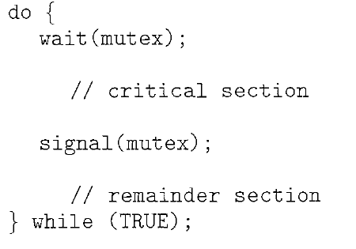
Binary semaphore
We can use binary semaphores to deal with the critical-section problem £or
multiple processes. Then processes share a semaphore, mutex, initialized to 1.
Each process Pi is organized as shown below
Mutual-exclusion implementation with semaphores.

Slide 11
Counting semaphore
Counting semaphores can be used to control access to a given resource consisting of a finite number o£ instances.
The semaphore is initialized to the number of resources available.
Each process that wishes to use a resource performs a wait() operation on the semaphore (thereby decrementing the count).
When a process releases a resource, it performs a signal() operation (incrementing the count).
When the count for the semaphore goes to 0, all resources are being used. After that,
processes that wish to use a resource will block until the count becomes greater than 0.

Slide 12
Semaphore
We can also use semaphores to solve various synchronization problems.
For example, consider two concurrently running processes: P1 with a statement S1 and P2 with a statement S2 .
Suppose we require that S2 be executed only after S1 has completed.
We can implement this scheme readily by letting P1 and P2 share a common semaphore synch, initialized to 0, and by
inserting the statements
S1;
signal(synch) ;
in process P1
and the statements
wait(synch);
S2; in process P2.
Because synch is initialized to 0, P2 will execute S2 only after P1
has invoked signal (synch), which is after statement S1 has been executed.

